Slide 1
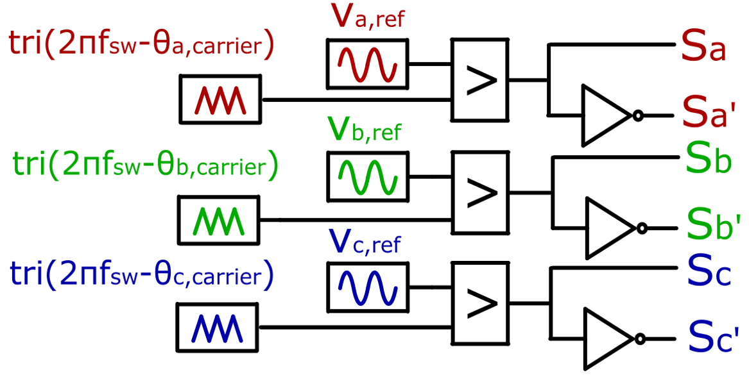
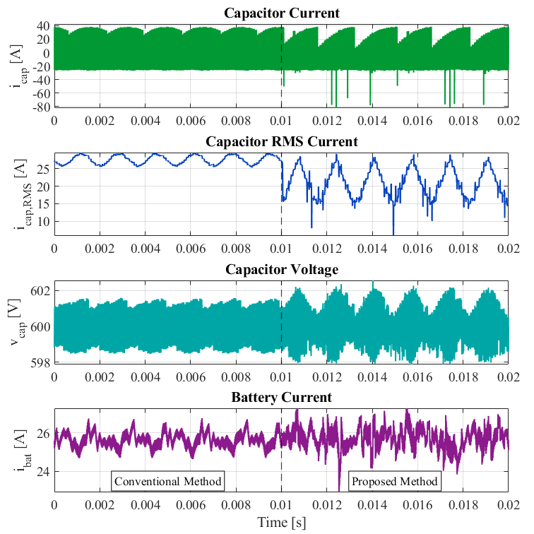
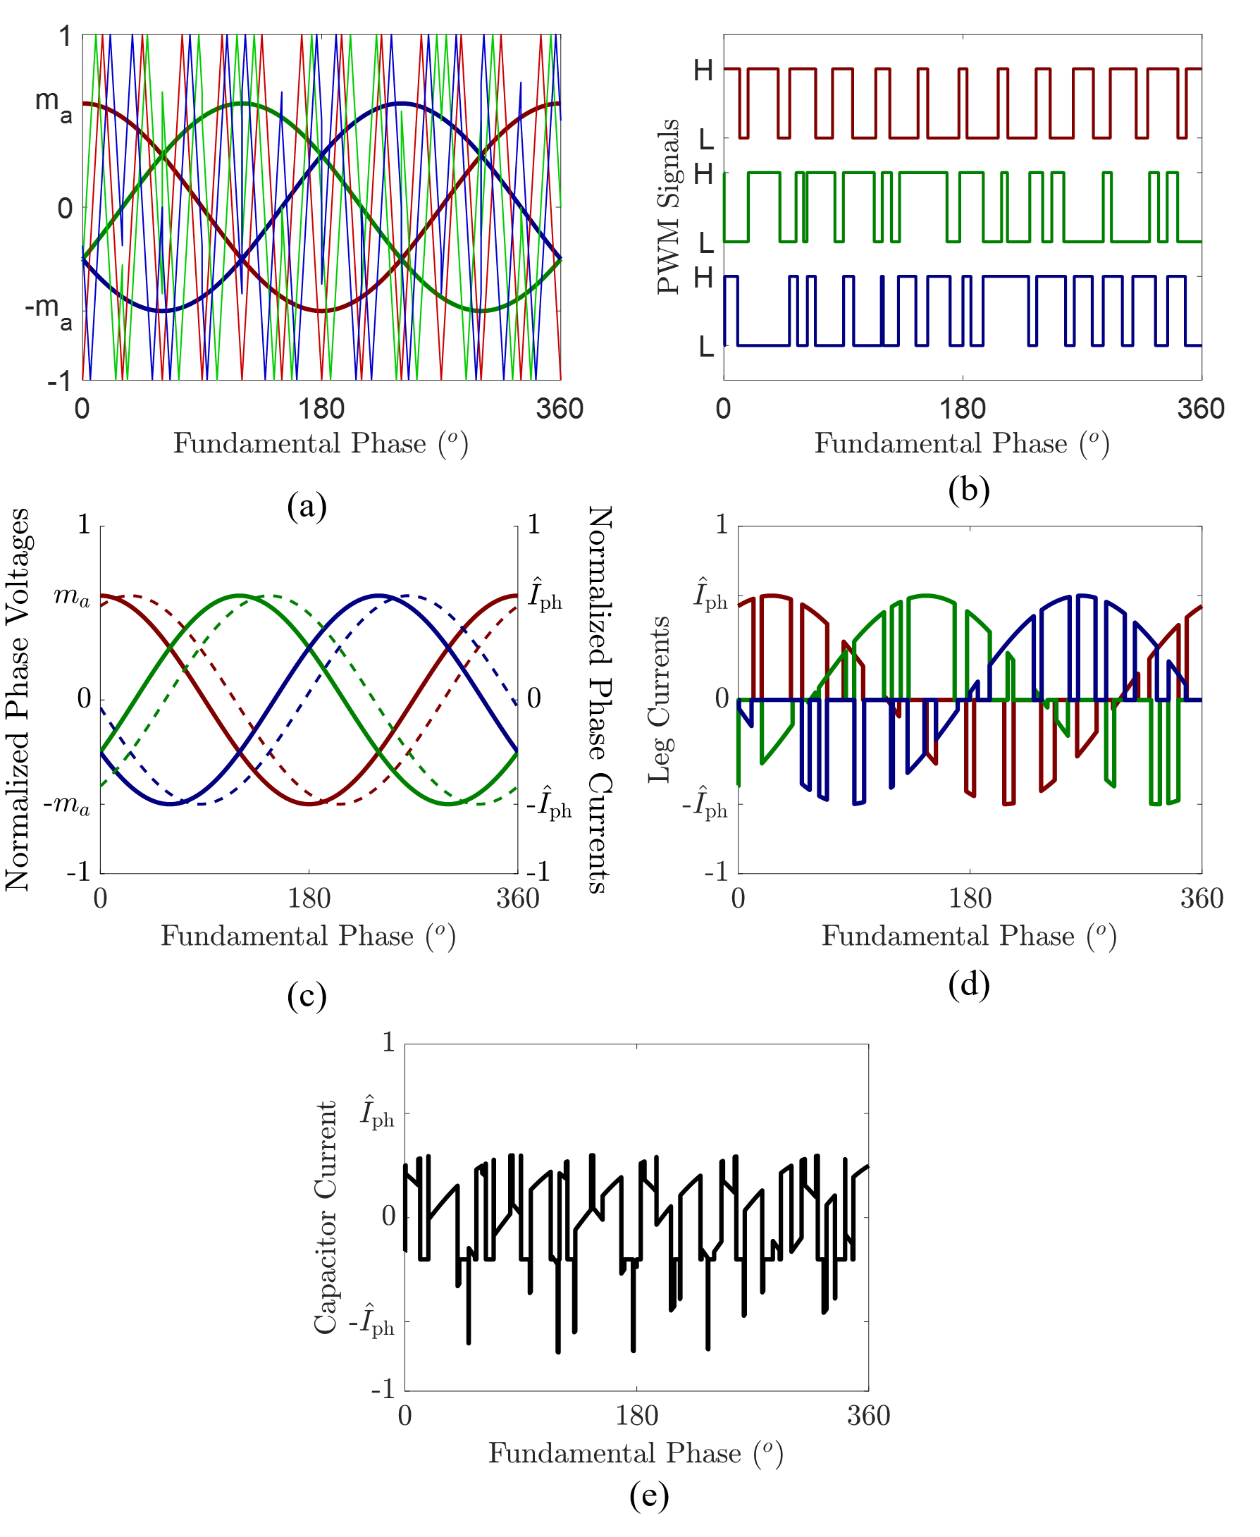
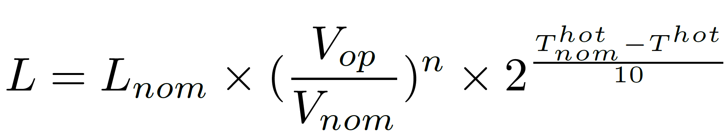
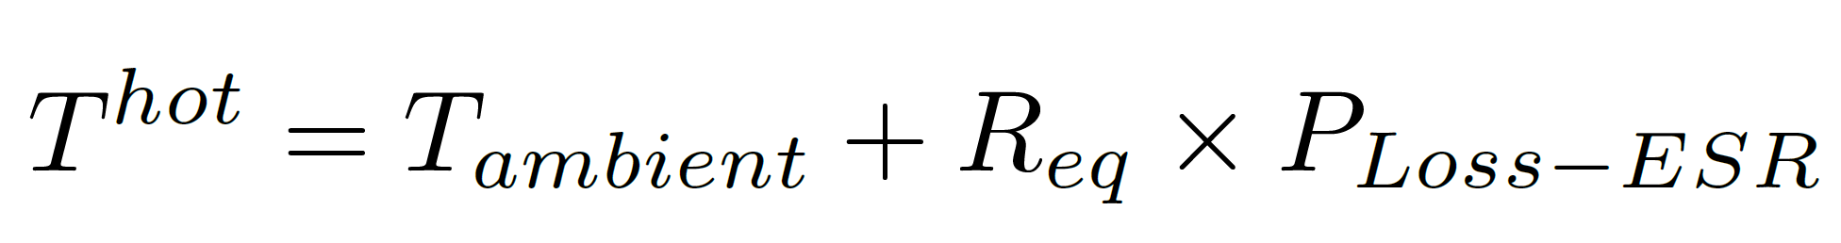
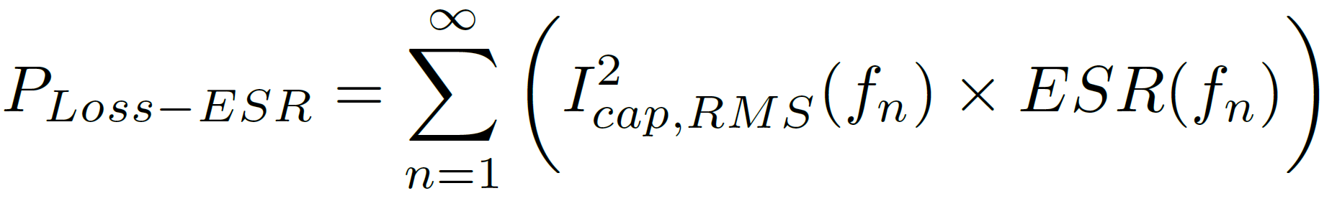
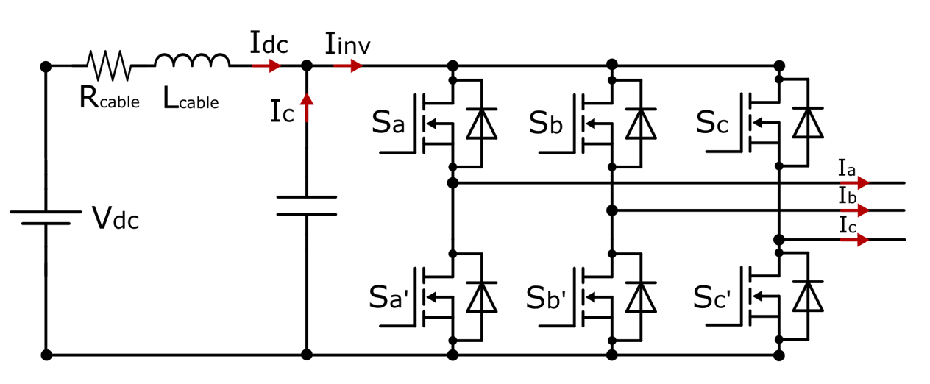
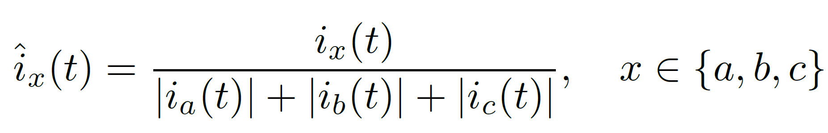
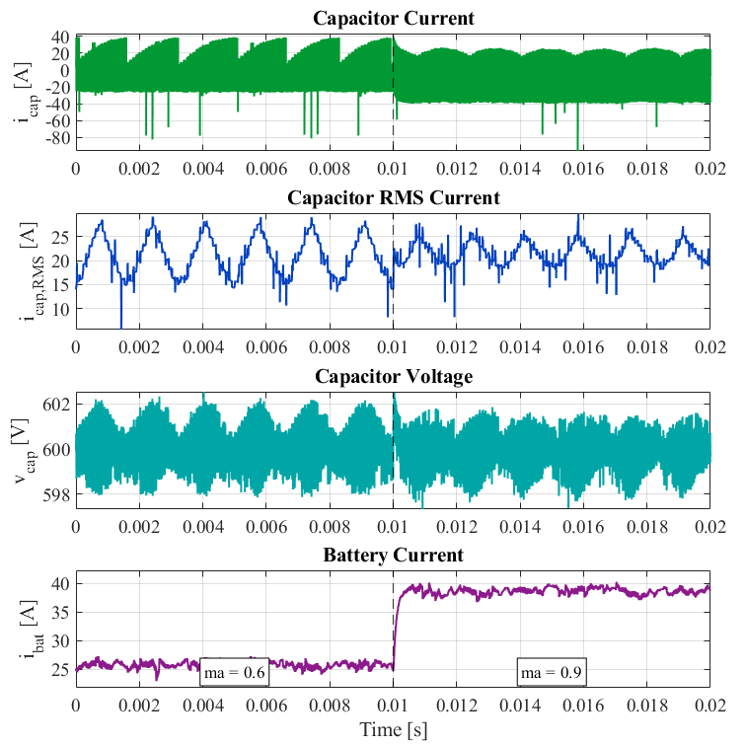
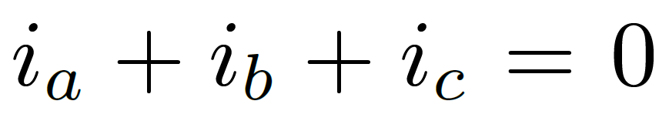

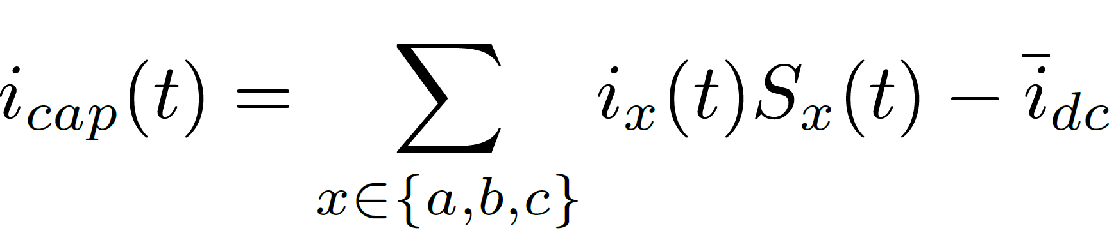

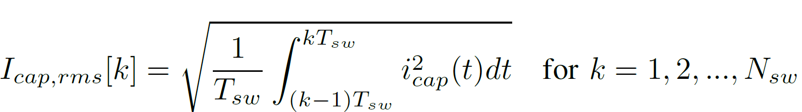
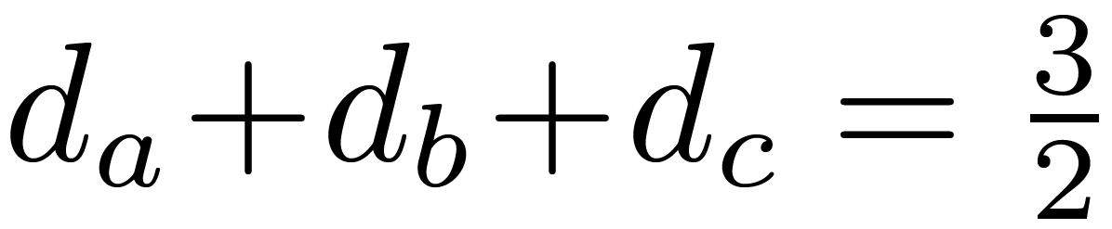
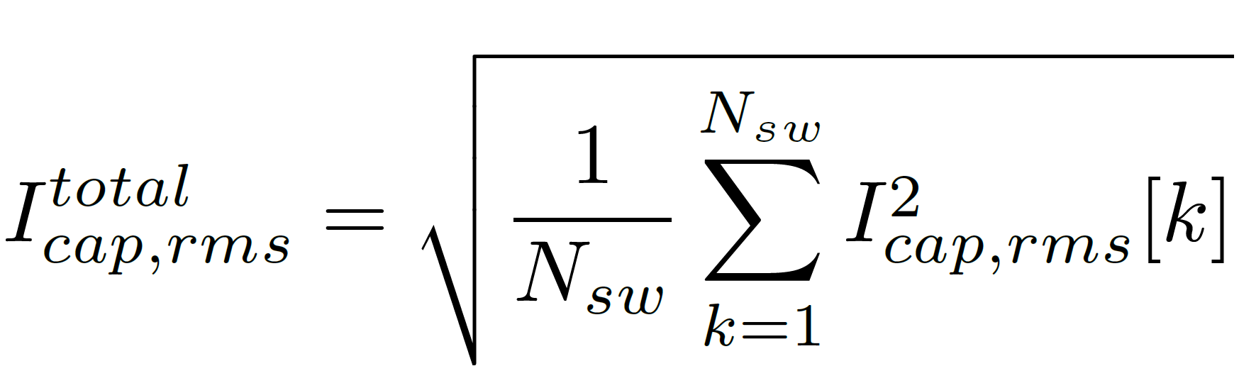
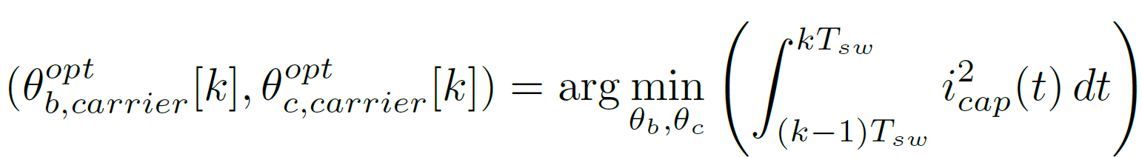
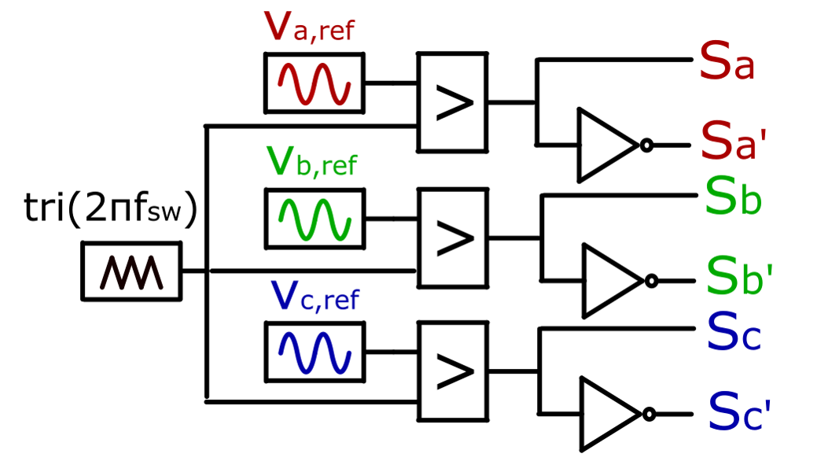
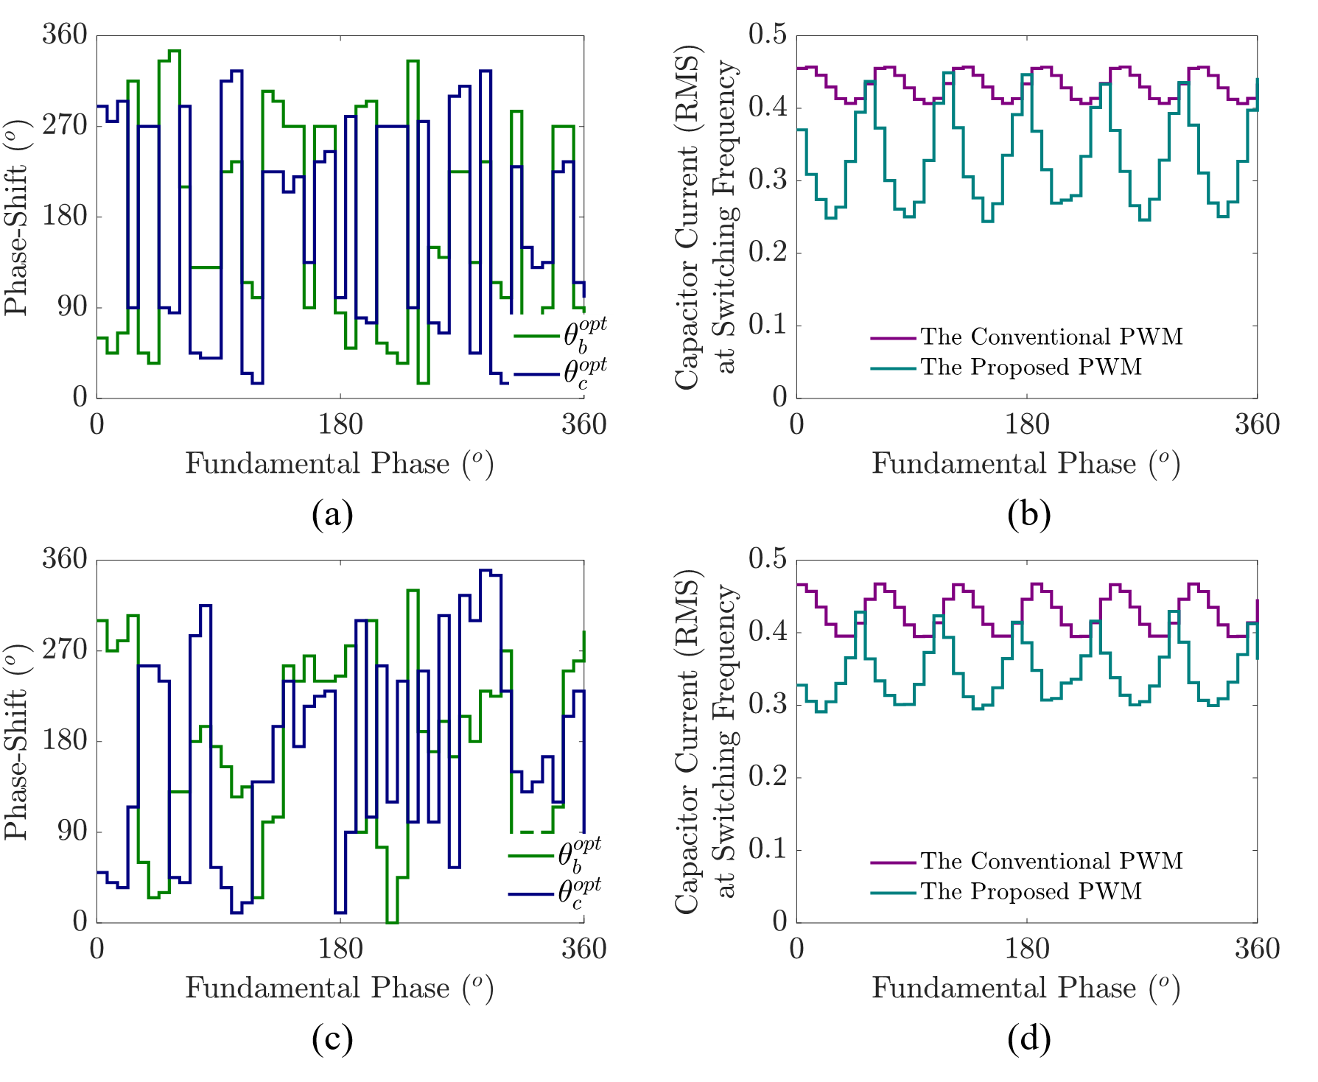
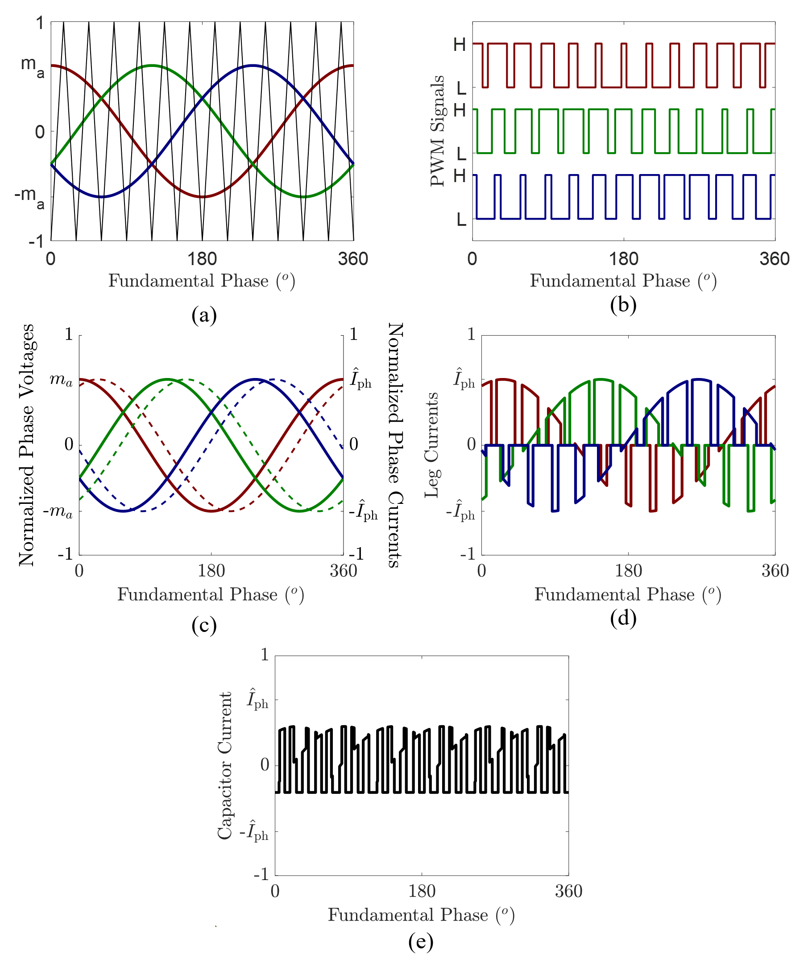
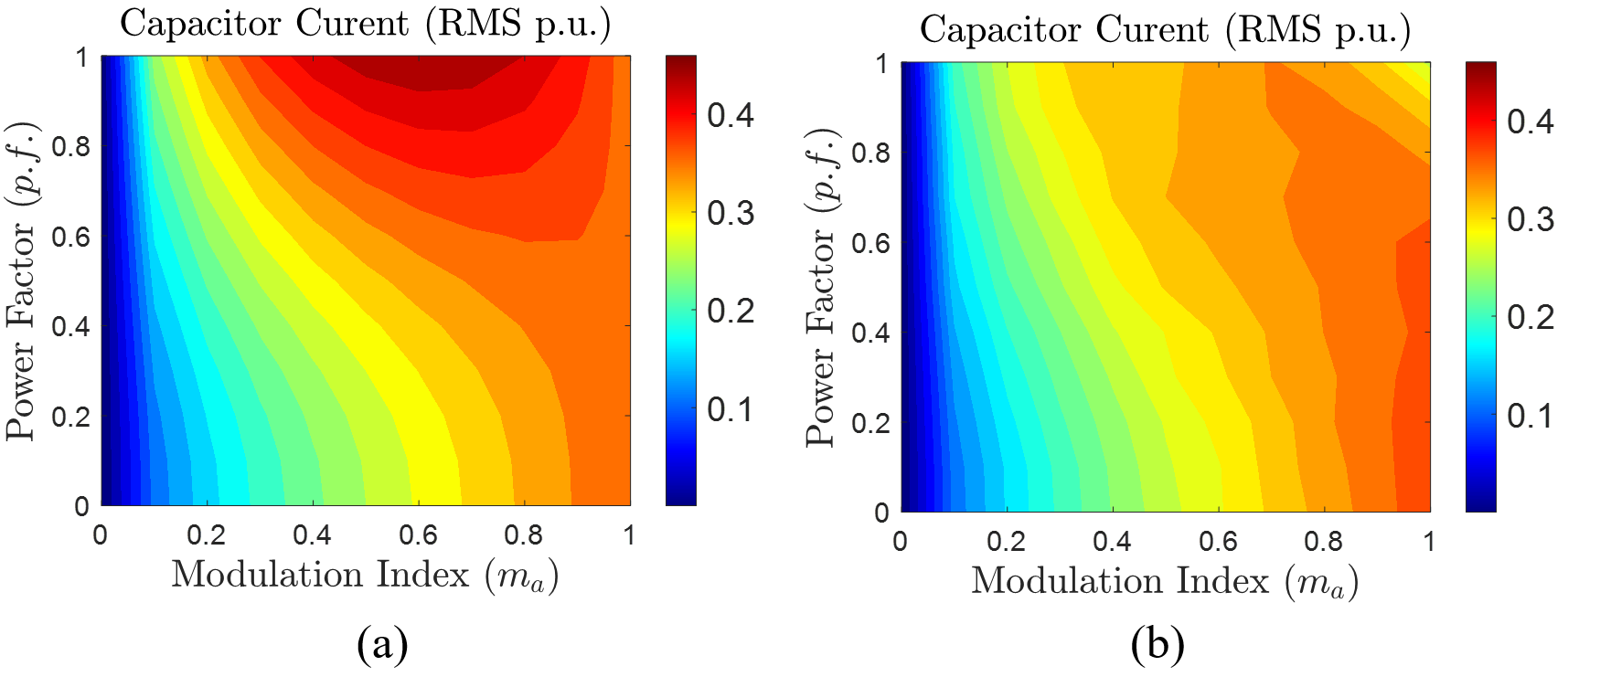










P1-8-12
Real-Time DC-Link Capacitor Stress Reduction in Two-Level Three-Phase Inverters Using Adaptive Multi-Carrier PWM Method
Enes Ayaz¹, Shahriar Sarmast Ghahfarokhi ¹, Staffan Norrga¹ , Hans-Peter Nee¹
¹KTH Royal Institute of Technology, Stockholm, Sweden
1
INTRODUCTION
5
PROPOSED MULTI-CARRIER PWM TECHNIQUE
8
SIMULATION VALIDATION
Two-level three-phase voltage source inverters are widely used in industrial motor drives.
Steady-state comparison ($m_{a}=0.6$, $p.f.= 0.9$)
DC-link capacitors remain a major reliability bottleneck. Ripple current causes ESR heating, thermal stress, degradation, and reduced capacitor lifetime.
Existing ripple-reduction methods often require multiple inverter units or additional converter stages.
This work proposes adaptive interleaving among the three legs of a single inverter using real-time multi-carrier PWM, without adding extra hardware.
2
DC-LINK CAPACITOR LIFETIME ESTIMATION
The capacitor lifetime is strongly affected by voltage stress and hotspot temperature.
Ripple-current-induced ESR losses increase the hotspot temperature, which accelerates degradation.
$$I_{cap, RMS}=27.6 A$$
$$I_{cap, RMS}=21.2 A$$
Therefore, reducing the RMS capacitor current directly reduces thermal stress and can extend the capacitor’s lifetime.
Reduction $\sim 23\%$
Hotspot temperature rise:
6
IMPLEMENTATION METHODOLOGY
$${15.2}^{ o}C$$
$${9 }^{o}C$$
Offline optimization & LUT-based real-time implementation
Reduction $\sim 40\%$
3
DC-LINK CURRENT ANALYSIS OF THE INVERTER
Estimated lifetime extension: $\sim 50 \%$
Current normalization:
Step change from $m_{a}=0.6$ to $m_{a}=0.9$
Under the balanced three-phase condition, current inputs reduce to
Capacitor Current:
Using the duty-cycle constraint in SPWM, duty inputs reduce to
RMS calculation within switching periods:
Look-up-table mapping
Total RMS calculation :
Optimization objective (per switching period k)
4
CONVENTIONAL SINGLE-CARRIER-BASED PWM
7
PERFORMANCE ASSESSMENT
Transient performance:
Smooth adaptation of carrier phase shifts.
Confirms real-time feasibility.
$m_{a}=0.6$, $p.f.= 0.9$
9
CONCLUSION
A novel adaptive multi-carrier PWM method is proposed for a single two-level three-phase inverter.
The method requires no additional hardware and uses a reduced-dimension LUT for real-time implementation.
$m_{a}=0.8$, $p.f.= 0.95$
The results show consistent DC-link capacitor RMS current reduction, improved thermal performance, and extended capacitor lifetime.
23%
~50%
case study
lifetime gain
27.6 A -> 21.2 A
example estimate
up to
27%
lower RMS current

